Slide 1

Social Distancing Detection
Team Members
Joseph Chelladurai.S-1020
Naveen.V-1035
Raghul Rajkumar.R-1044

Slide 2
Abstract
This project aims to develop a system for monitoring and enforcing social distancing in public spaces using computer vision and machine learning techniques.
The system will utilize cameras and sensors to detect and track individuals in a given area, and will use algorithms to determine the distance between individuals and alert authorities or display warning messages if a safe distance is not being maintained.

Slide 3
Problem Definition
In crowded environments, supervisors and helpers are not able to control the required social distancing of people as they are limited to supervising one or few people in the crowd.

Slide 4
Objective of the Project
So with this project, we are trying to connect to cameras in public and safety required places like schools, colleges, hospitals and airports to detect and inform people to maintain their distance. This way we can help in controlling these circumstances in a much more efficient way. Like an eye in the sky to help us.

Slide 5
Literature Survey
"Real-time Social Distancing Detection using Deep Learning and Computer Vision" - https://ieeexplore.org/abstract/document/9138645/
"A Multi-Camera System for Social Distancing Monitoring" - https://ieeexplore.org/abstract/document/9238613/
"Smart Social Distancing System based on Wireless Sensor Network and Computer Vision" - https://ieeexplore.org/abstract/document/9181736/
"Real-time Social Distancing Monitoring using Thermal Imaging and Computer Vision“-https://ieeexplore.org/abstract/document/9195421/
“Social Distancing Detection with Deep Learning Model” –
https://ieeexplore.ieee.org/document/9243478/

Slide 6
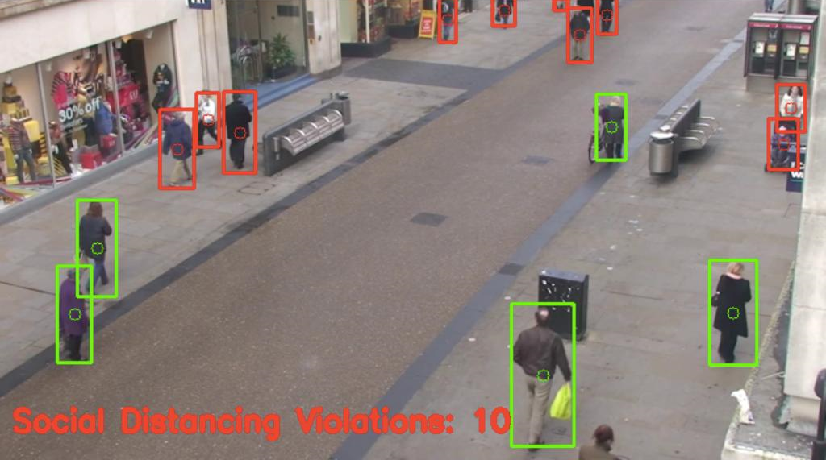
Existing System
Detection of people using camera.
Outlines people based on the distance they are maintaining in the environment with red and green boxes.
Places violation counters based on the people with red boxes (close to each other).

Slide 7
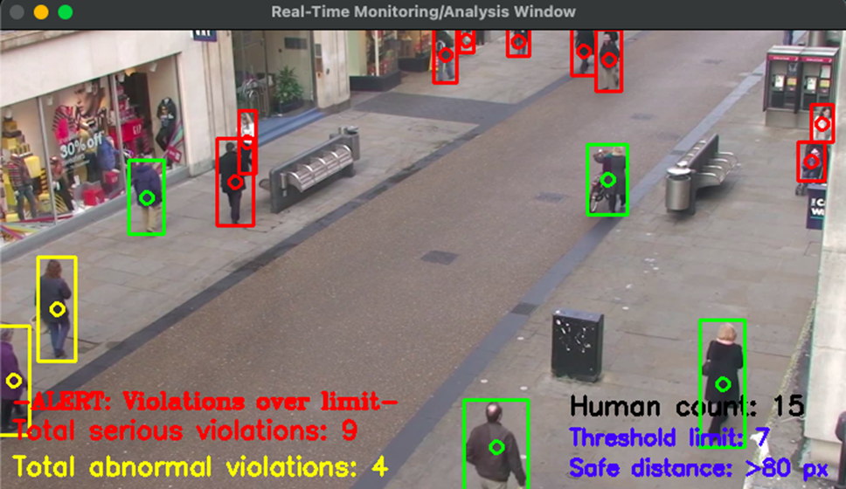
Proposed System:
Added abnormal violation layout (yellow box) which denotes if a person or a group of people are expected to come in contact.
Audio output which warns them if the measures are violated more than a dedicated violation counter.

Slide 8
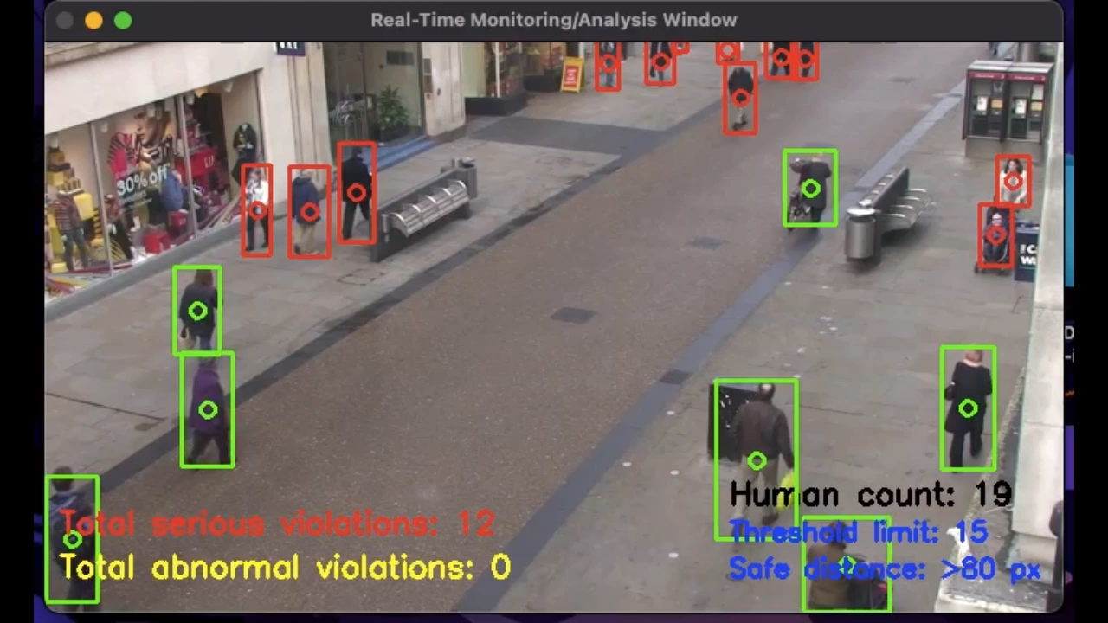
Demo Video

Slide 9
Software Requirements:
Python
Microsoft Windows/ MAC OS/ Linux
Hardware Requirements:
Systems with higher GPU processing
8GB RAM or more
Dedicated Graphics card
Top-Down view 2D-camera

Slide 10
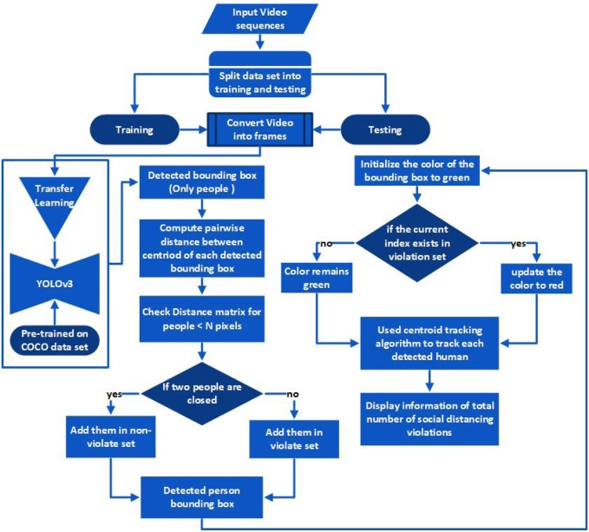
UML Diagram

Slide 11
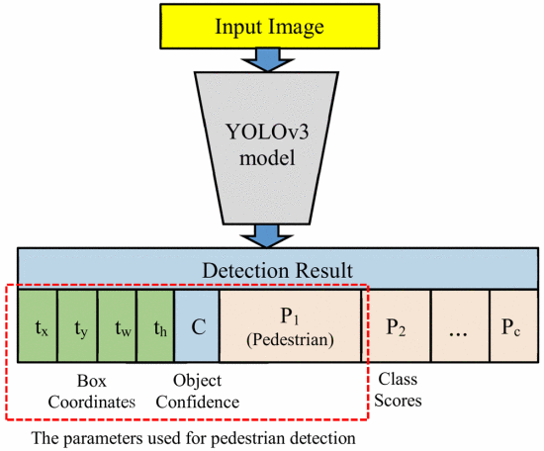
Architecture Diagram

Slide 12
Modules Description
YOLOv3 (You Only Look Once version 3) is a real-time object detection system that utilizes deep learning and convolutional neural networks to detect and classify objects within an image or video frame.
YOLOv3 works by dividing an image into a grid and using each cell of the grid to predict multiple bounding boxes and the corresponding class probabilities. The output of YOLOv3 can be used for various computer vision tasks such as object tracking, image segmentation, and image classification.

Slide 13
Conclusion
Using the YOLOv3 algorithm the cameras are used to detect the distance of each person and calculate the distance of the people in the environment using Euclidian's distance formula and alarm them if they are too close to each other via the external speakers. By using this detection system we can ensure that social distancing guidelines are being followed. The system is highly effective in monitoring large crowds in real-time and providing real-time feedback.

Slide 14
Reference
Ahmed M. AlHosani, et al. - IEEE Access
Jiajia Liu, et al. - IEEE Transactions on Emerging Topics in Computational Intelligence
Yiran Wang, et al. - IEEE Internet of Things Journal
Shaohua Tan, et al. - IEEE Sensors Journal
Yew Cheong Hou - Institute of Informatics and Computing in Energy.
Mohd Zafri Baharuddin - College of Engineering, Universiti Tenaga Nasional, Kajang, Selangor, Malaysia.
Salman Yussof - Institute of Informatics and Computing in Energy.
Sumayyah Dzulkifly - Institute of Informatics and Computing in Energy.

